Slide 1
TOPOGRAPHIC DIFFERENCING: EARTHQUAKE ALONG THE WASATCH FAULT
AUTHOR: CHUKWU CHINYERE PRECIOUS

Slide 2
SEISMIC RISK IN UTAH AND HOW PEOPLE SHOULD PREPARE
Overview
Utah has experienced sixteen earth-quakes greater than magnitude 5.5 since pioneer settlement in 1847, and geologic studies of Utah’s faults indicate a long history of repeated large earthquakes of magnitude 6.5 and greater prior to settlement. Utah is not on a boundary between tectonic plates where most of the world’s earthquakes occur, but rather is in the western part of the North American plate. Between Utah’s Wasatch Range and California’s Sierra Nevada, tectonic forces within the western part of the North American plate combine with high heat flow from the underlying mantle to literally stretch the crust in an east-west direction at the rate of about one-half inch per year. In response to this stretching, the rigid crust breaks and shifts along faults, and the fault movement produces earthquake also, Earthquakes in Utah are indirectly caused by interactions with the Pacific plate along the plate margin on the west coast of the United States. Many small earth-quakes in east-central Utah are induced by underground coal mining
The Wasatch Fault, One of the longest and most active normal faults in the world, the 240-mile-long Wasatch fault extends from Malad City, Idaho, south to Fayette, Utah. The fault is subdivided into 10 segments, averaging 25 miles in length; each segment is generally thought to rupture independently and is a separate source of large earth-quakes. Although scientists are unsure about how many small- to moderate-size historical earthquakes can be attributed to slip on the Wasatch fault at depth, the geologic record shows that numerous large (magnitude 6.5-7.5) surface-faulting earthquakes have taken place on the Wasatch fault over the past 10,000 years.

Slide 3
Utah’s People, Economy, and Infrastructure are Increasingly Vulnerable to a Wasatch Fault Earthquake
Nearly 80 percent of Utah’s population lives within 15 miles of the Wasatch fault in the Wasatch Front area. More than 75 percent of Utah’s economy is concentrated in Salt Lake, Utah, Davis, and Weber counties—above the Wasatch fault, which projects beneath the developed Wasatch Front valleys. Most of Utah’s state government facilities are located within 15 miles of the Wasatch fault. Major interstate transportation corridors and the Salt Lake City International Airport are located within 15 miles of the Wasatch fault. By 2030 the population in the Wasatch Front area is projected to grow to 2.8 million, a 50 percent increase over 2005.To meet the needs of the dramatically growing population along the Wasatch Front, $14.4 billion of new transit and highway infrastructure is planned over the next three decades .
Why is earthquake preparedness important in Utah?
Utah has experienced damaging earthquakes in the past and geologic evidence indicates that earthquakes larger than any experienced locally in historical time are likely in the future.
We must prepare for earthquakes because:
Utah is a seismically active region
A majority of Utah's population is concentrated in the areas of greatest hazard
Many of Utah's older buildings and lifelines have low earthquake resistance

Slide 4
The Seven Steps to Earthquake Safety
Earthquakes in Utah are inevitable, but damage from them can be reduced. Steps to take before, during, and after earthquakes.
BEFORE QUAKE
STEP 1. Identify potential hazards in your home and begin to fix them
STEP 2. Create a disaster-preparedness plan
STEP 3. Prepare disaster supply kits
STEP 4. Identify your building’s potential weaknesses and begin to fix them
DURING QUAKE
STEP 5. Protect yourself during earthquake shaking
AFTER QUAKE
STEP 6. After the earthquake, check for injuries and damage
STEP 7. When safe, continue to follow your disaster-preparedness plan
REFERENCE
Utah seismic safety commission 2008. Putting down roots in Earthquake country, salt lake city, Utah. https://www.utah.gov/beready/documents/roots_earthquake_low.pdf
https://www.utah.gov/beready/family/earthquake.html
https://www.utah.gov/beready/earthquakePreparedness.html
https://www.utah.gov/beready/documents/HazardsHandbookDraft8.pdf

Slide 5
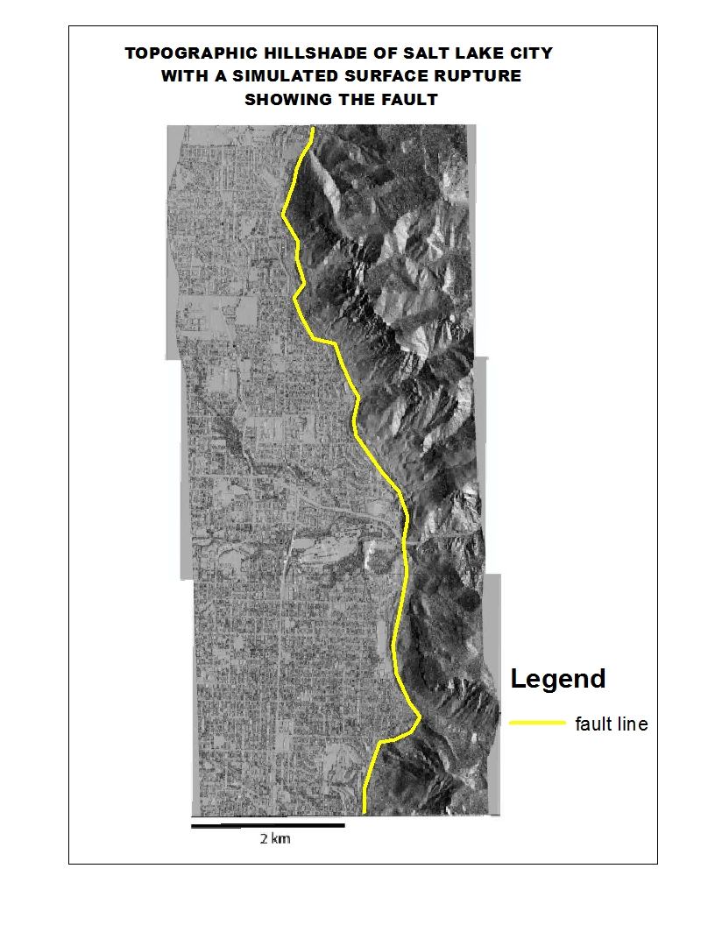
Question 2
Where is the surface rupture in
relationship to Salt Lake City?
Utah's biggest earthquake fault runs east of Salt Lake City, at the base of the steep Wasatch Mountains.
Is the fault straight?
The fault is not straight, it is bent in several areas as we can see from the map.
What else is important?
The Salt Lake fault segment is one of several independent rupture segments in the Wasatch normal fault zone, Utah. The segment is about 35 km long and consists of several, approximately linear fault sections that intersect in geometrical barriers defined by bends and branching of the fault trace

Slide 6
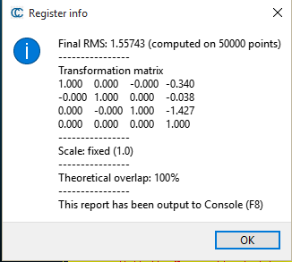
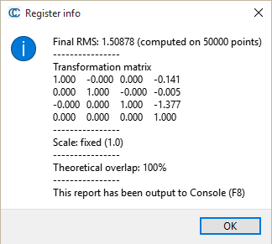
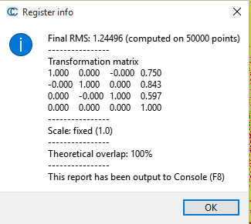
Question 3.
List at least three displacement measurements made in Cloud Compare on both the hanging wall and the footwall.
Distance from fault (km) | East-west displ. (m) | North-south displ. (m) | Vertical displ. (m) | Quality estimate Table
-1.296(West) | -0.340 | -0.038 | -1.427 | 1.557
-0.367 (West) | -0.141 | -0.005 | -1.377 | 1.508
0.570 (East) | 0.750 | 0.843 | 0.597 | 1.244
Include a quality estimate and describe what impacts your quality estimate.
The size of the post-earthquake area used for this analysis Impacts the quality estimate, as we observed, the size of the post-earthquake area used was slightly bigger than the pre earthquake imagery , it also known that the bigger the window the lesser the error.

Slide 7
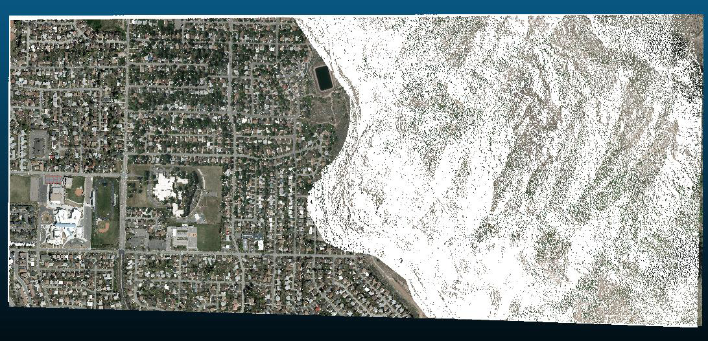
Question 4
Plot your measurements in Figure 4. Use arrows to draw horizontal displacements on the map. Include a scale bar for the displacements. Use an open circle to denote upward motion and a closed circle to denote downward motion. What type of fault was activated in this earthquake? Explain your answer. Hint: the fault is dipping to the west.
Based on the measurement, the type of fault activated is the dip-slip fault which is a type of normal fault . The hanging wall moves downwards relative to the footwall and from the analysis we can see that the areas in the west side of the fault moved downward, while the areas at the east side of the fault moved upwards.

Slide 8
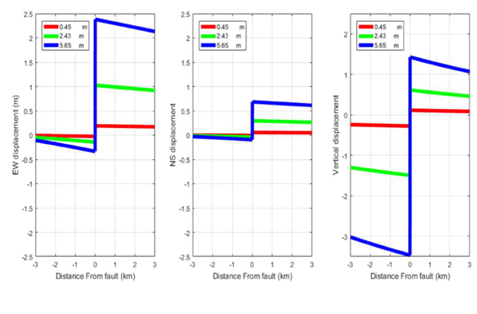
Question 5
How much did the fault slip during the earthquake? Use Figure 5 and explain how you arrived at your answer.
GRAPH 1

Slide 9
GRAPH 2

Slide 10
GRAPH 3
Surface displacement profiles produced by 0.45 m (red), 2.43 m (green), and 5.62 m (blue)
From observations of surface displacement in the plots of area to the surface displacement,
we can see that the best-fitted profile is the green profile, which infers that the on-fault slip
caused by the earthquake is about 2.43 m

Slide 11
Question 6
What are the sources of error in the surface displacement measurements? How did the error impact your answers to Questions 4-5?
A lot of things can be the source of error in displacement measurement
It could be systematic error, that is error from the instrument used.
Example of such error could be error from the laptop, Laptops with low memory
or slow processing speed can introduce error in the measurement.
2. Error could arise from the point cloud data set, if the imagery is not clear then
there is bound to be an error.
3. It could also be a Random error, i.e Blunders and Gross errors made by the observer.
From the data and analysis, we can see that these sources have not
greatly affected the results, due to the high quality of data used.

Slide 12
Question 7
Pretend your aunt lives in Salt Lake City and is apprehensive about the
earthquake risk. In non-technical language, explain to her the seismic risk of living in Salt Lake City and the early response to an earthquake. What should she do to prepare?
Utah has experienced damaging earthquakes in the past and geologic evidence indicates that earthquakes larger than any experienced locally in historical time are likely in the future.
precautions has to be taken to be fully prepared for the seismic occurrence.
refer to Question 1 for detailed safety precautions

